Slide 1

Financial Management for Engineers
APS 1016 H Summer 2019 Week 7

Slide 2

Calculating PV of a common stock
PV = D₁/1+r + D₂/(1+r)² + D₃/(1+r)³ ………
If the dividends are growing at a constant rate then
PV = D₁/r-g
Where r is the required rate of return on a common stock and g is the growth in dividends in %
Example lets look at Alcoa . Over the last four years the company has not paid dividends. The stock is currently (May 30th 2019) trading at $22.05 per share.
The dividend growth model is clearly not applicable in the case of Alcoa valuation
APS 1016 H Summer 2019 Week 7

Slide 3
Technology and engineering companies are generally not valued based on their dividend payouts.
The two major valuation metrics that are used are: multiples of earnings and cash flow
Telecommunications companies on the other hand provide a steady cash flow stream and thus dividend growth model can be applied in its valuation
APS 1016 H Summer 2019 Week 7

Slide 4
Let us take examples of AT&T and BCE
AT&T: In 2014 the company paid an annual dividend of $1.85 per share, by 2018 the annual dividends have risen to $2.01 per share, indicating an annual growth rate of 1.67 %. The stock is currently(May 30th 2019) trading at $31.73, which implies a required rate of return of 8.11 %, assuming annual constant growth of 1.67% for dividends
APS 1016 H Summer 2019 Week 7

Slide 5
In a similar format let us look at BCE. In 2014 the company paid an annual dividend of $2.47 per share rising to $3.02 per share by 2018, implying an annual growth rate of 4.10%. The stock is currently trading at $61.11. Assuming next years DPS of $3.14, implying a required rate of return of 6.25%, assuming dividends will grow at the annual rate of 4.10%
APS 1016 H Summer 2019 Week 7

Slide 6

Earnings provide a basis for dividends and capital gains
We can use P/E multiple to indirectly value companies
P/E multiple must be used with caution
Companies will have different P/E multiples, based on their risk profile and growth opportunities
A company with greater growth opportunities( earnings and cash flows that are growing at a faster rate relative to their peers) will command a higher P/E multiple relative to the industry average
APS 1016 H Summer 2019 Week 7

Slide 7
Continuing with our Bell and AT&T example
Bell commands a P/E multiple of 19.2 and AT&T commands a P/E of 11.9( May 30th 2019). Discuss its implication
APS 1016 H Summer 2019 Week 7

Slide 8
Example:
Company A and B both report $1 in EPS this year. Should they both be valued equally?
Assume both companies distribute all their earnings in the form of dividends and there are no tax effects. Both the companies are in the same risk category therefore their required rate of return is the same. In this case lets assume that the required rate of return is 10%.
Company A earnings growth = 8% forever. Company B earnings grow at 2% forever
APS 1016 H Summer 2019 Week 7

Slide 9
PV_{A} = 1.08/(.1-.08) = $ 54
PV_{B} = 1.02 /(.1-.02) = $ 12.75
Therefore for every $ 1 in trailing earnings Co A will have a present equity value of $54 whereas Co B will have a present equity value of $12.75
Lets look at earnings growth of selected engineering and technolgy companies
APS 1016 H Summer 2019 Week 7

Slide 10

SNC Lavalin
EPS:2018: ($7.50) 2017:$2.34 ; 2016: $1.70 ;2015: $2.68; 2014: $8.74
The fie year period shows no discernible pattern of earnings growth
Russel metals
EPS:2018: $3.52 2017: $2.00; 2016: $1.01; 2015: $(1.42); 2014: $1.95
No discernible earnings growth pattern over the five year period
APS 1016 H Summer 2019 Week 7

Slide 11
Freeport McMoran
EPS: 2018: $1.78 2017: 1.25 , 2016: $(3.16), 2015: $(11.31); 2014: $(1.26)
EPS growth trending lower over the last five years, positive earnings in year 2017 and 2018
Clearly from the above three examples it is not easy to value companies simply by looking at past growth in earnings and assuming that the earnings will keep growing at the same rate. In some cases the method may be applicable in others not
APS 1016 H Summer 2019 Week 7

Slide 12
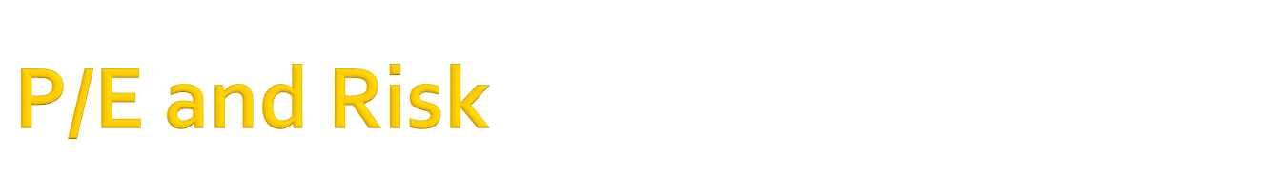
Risky companies will command a lower P/E multiple
Example
P₀ = D₁/r-g
Using the above dividend growth model
Take two companies. Both will pay dividends of $4.50 per share and the dividends are expected to grow at a constant rate of 5% per year forever. However company A is more risky and based on the security market line the required rate of return for company A is 18%, whereas company B is less risky and the required rate of return based on the security market line is 10%. What are the respective P/E multiples for each company?
APS 1016 H Summer 2019 Week 7

Slide 13
P_{A} = 4.5/(.18-.05 ) = $34.62
P_{B} = 4.5/(.1-.05) = $90
If all earnings are given out as dividends then
P_{A}/E₁= 34.62/4.5 =7.69
P_{B}/E₁ = 90/4.5 = 20
Therefore since company A is more risky than company B it commands a lower P/E multiple
So P/E multiples must be used with caution. One size does not fit all
APS 1016 H Summer 2019 Week 7

Slide 14

Co | P/E | $ price
BB(Blackberry) | 47.3 | 10.66
Open Text | 38.8 | 53.79
SNC lavalin | N/A | 23.53
ShawCor(SCL) | 80.0 | 17.16
APS 1016 H Summer 2019 Week 7

Slide 15

Co | P/E | $ price
Russel Metals | 6.2 | 21.23
Tormont(TIH) | 18.8 | 59.38
Verizon | 15.0 | 56.695( US)
AT&T | 11.9 | 31.855(US)
BCE | 19.5 | 61.06
Microsoft | 27.8 | 125.315
APS 1016 H Summer 2019 Week 7

Slide 16

We can estimate the value of a company by estimating its future operating cash flow and discounting that future cash flow back to present value using the appropriate discount rate
PV = CF₁/(1+k) + CF₂/(1+k)² + CF₃/(1+k)³ + …….
Where CF₁ = cash flow for year 1 and k = discount rate or WACC( weighted average cost of capital)
APS 1016 H Summer 2019 Week 7

Slide 17
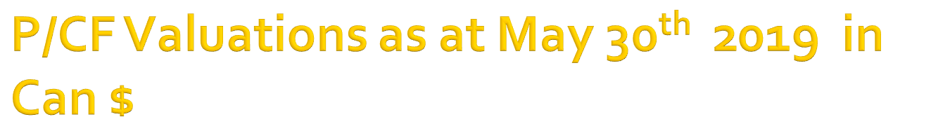
Co | $ CF/share 2018 | P/CF | $ Price
BB | .1825 | 58.3 | 10.64
Open Text | 2.64 | 2.2 | 53.78
SNC Lavalin | (18.93) | N/A | 23.56
ShawCor | 0.44 | 39.09 | 17.2
APS 1016 H Summer 2019 Week 7

Slide 18

Co | $ CF/share 2018 | P/CF | $ price
Russel Metals | 1.42 | 15.0 | 21.31
Tormont | 6.21 | 9.54 | 59.27
Verizon | 8.29 | 6.85 | 56.795
AT&T | 5.97 | 5.35 | 31.945
BCE | 8.21 | 7.43 | 61.03
Microsoft | 5.77 | 21.71 | 125.27
APS 1016 H Summer 2019 Week 7

Slide 19

A company with no long term debt in its capital structure is known as unlevered.
Unlevered cash flow can be calculated as thus:
Sales revenue | $ 100,000
COGS | 60,000
Operating income | 40,000
Corp. tax @ 40% | 16,000
Unlevered CF | 24,000
APS 1016 H Summer 2019 Week 7

Slide 20

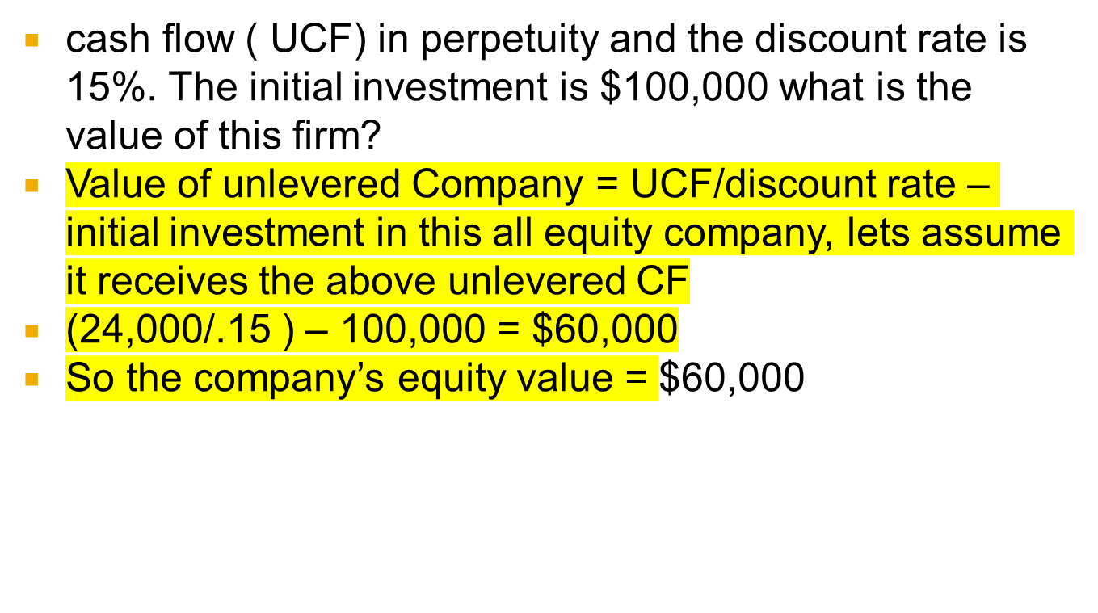
APS 1016 H Summer 2019 Week 7

Slide 21

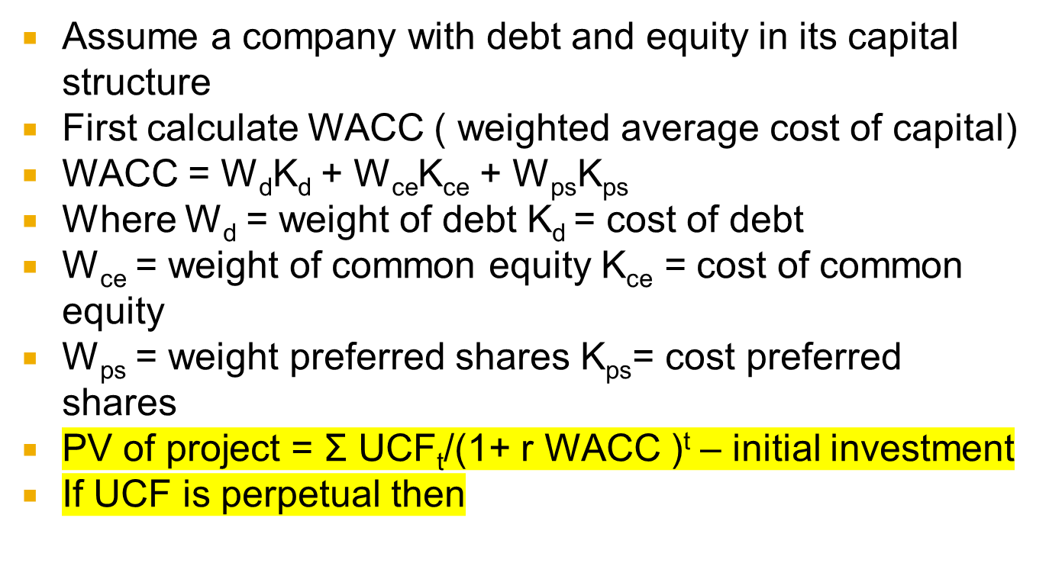
APS 1016 H Summer 2019 Week 7

